Slide 1
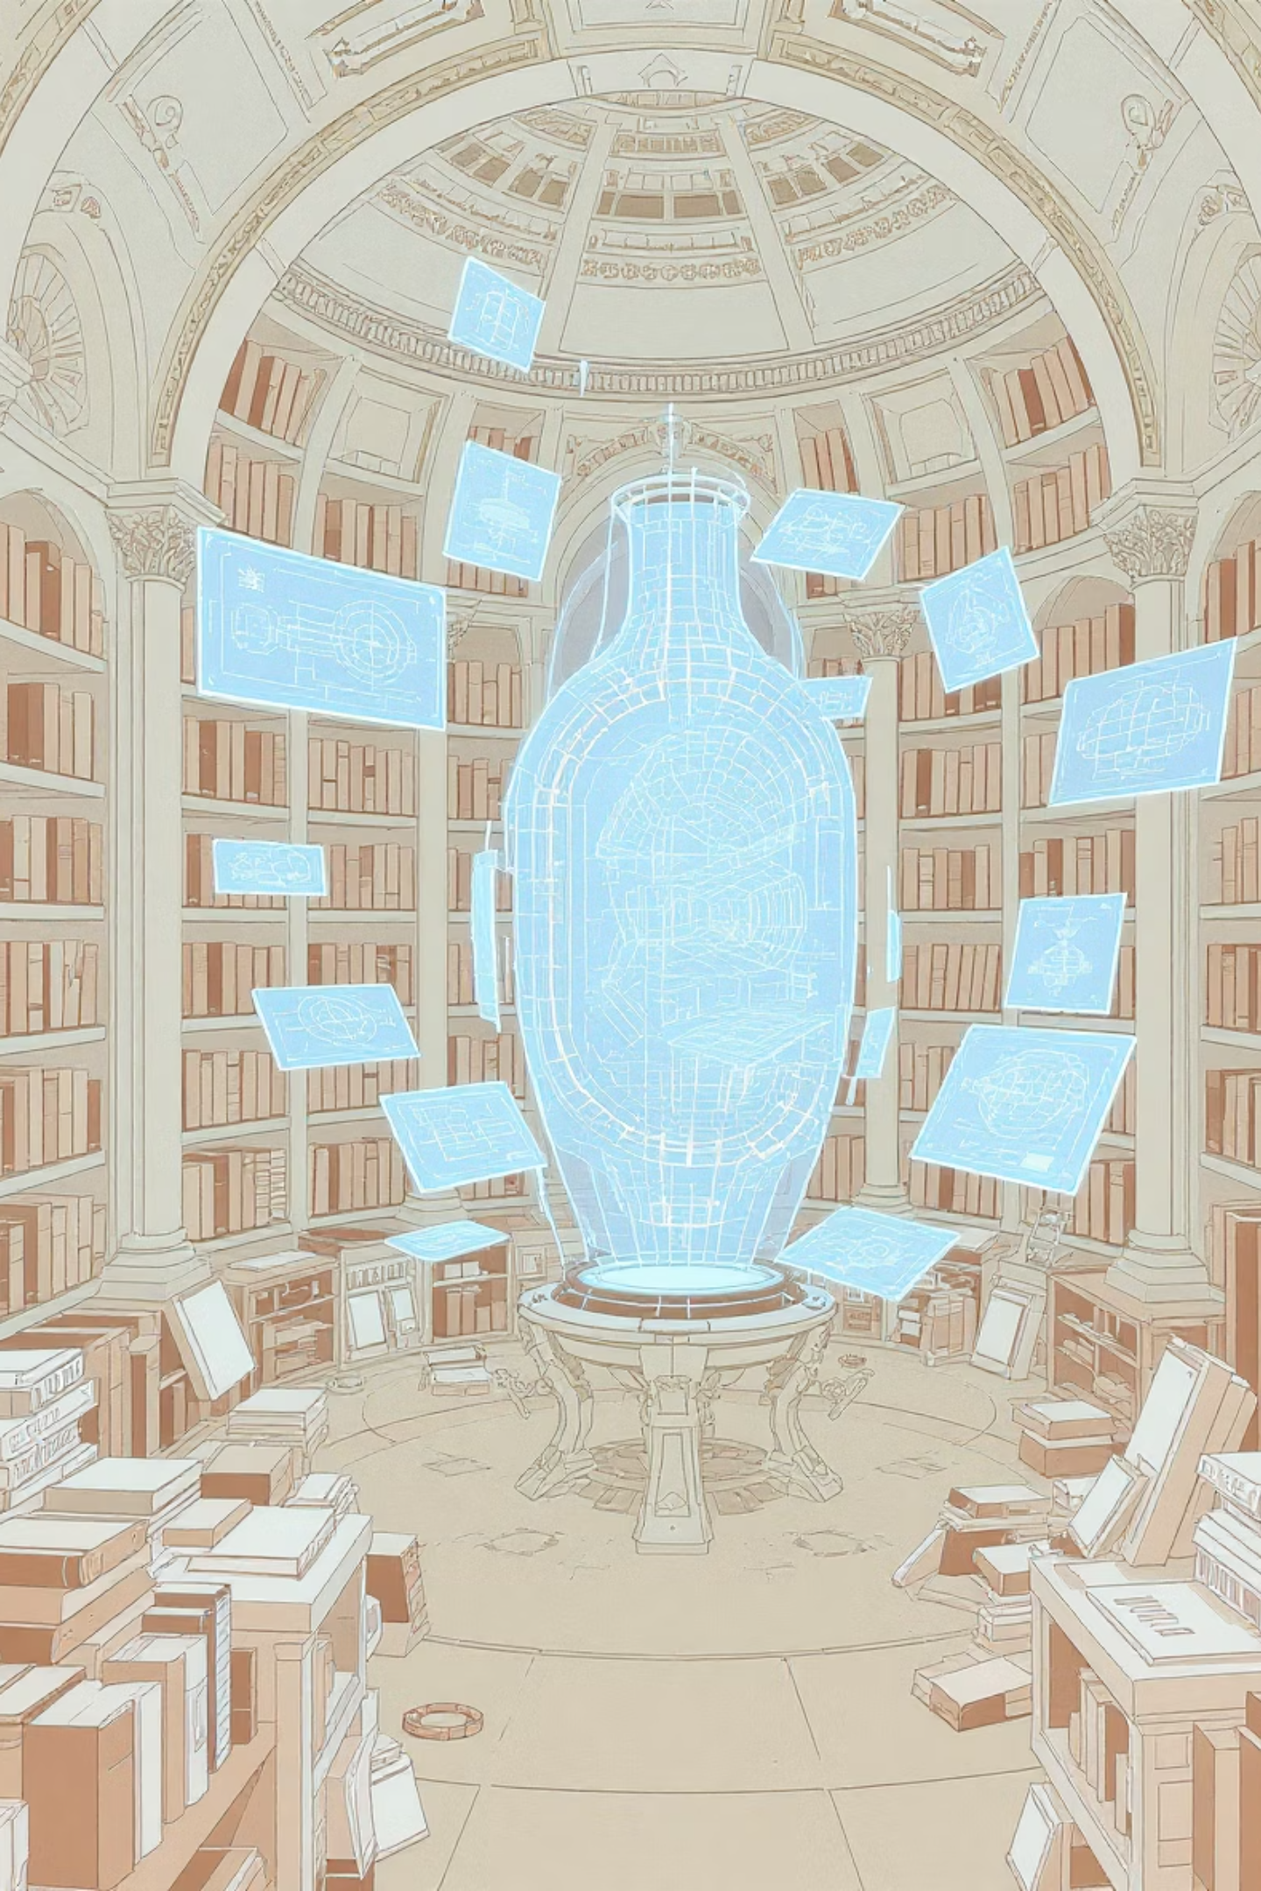
The Retro-Vision
Reimagining History, Inspiring the Future
project by Team - RetroManiac
Sandesh Anvekar
Aaroh Wankhede
Kavin Sarode
Himannk Khattr

Slide 2
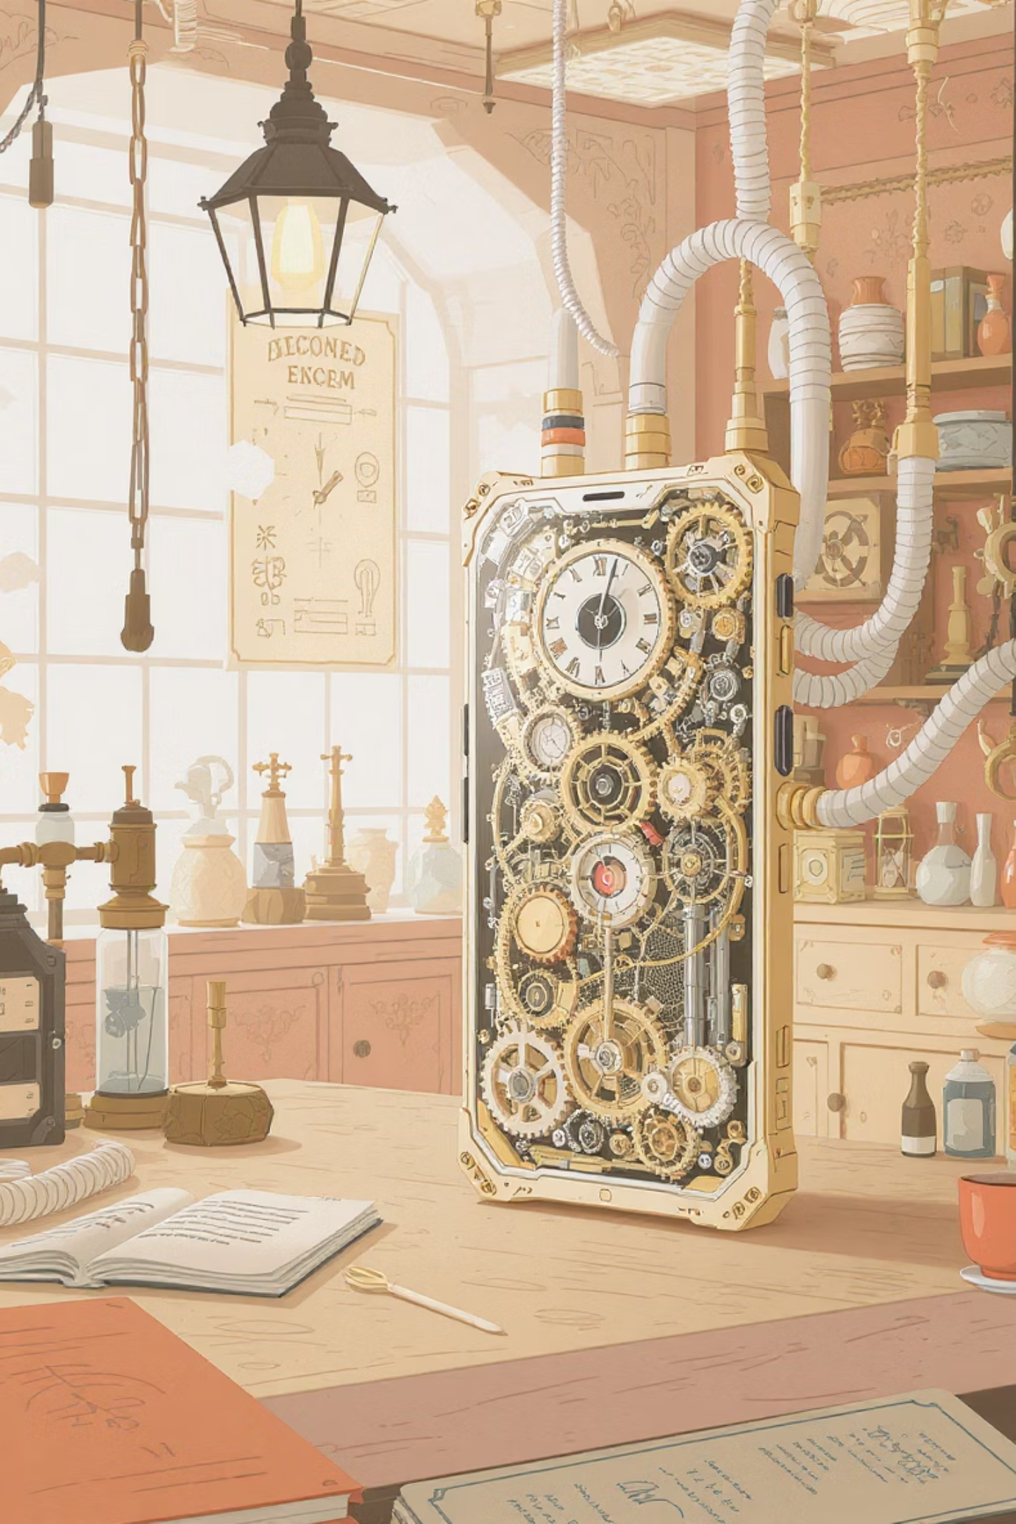
Chapter 1
The Uncharted Territories of Innovation
We often celebrate monumental inventions – the smartphone, the airplane, life-saving vaccines. But what about the roads not taken? The alternative paths these discoveries might have followed? Imagine if the smartphone emerged two centuries earlier, or if ancient civilizations harnessed electricity before the Industrial Revolution. Our understanding of innovation is often linear, neglecting the rich tapestry of 'what ifs.'

Slide 3
The Problem: A Gap in Creative Exploration
"What if the steam engine led to computers instead of trains?"
Currently, no tool exists to help us systematically explore these alternate invention histories. This creates significant limitations for:
Students & Educators: Missing out on creative, engaging learning experiences that could deepen historical understanding and critical thinking.
Innovators & Researchers: Overlooking potential "missed pathways" that could spark groundbreaking new ideas in their own fields.
Writers, Filmmakers, & Creators: Lacking a dedicated source of inspiration for rich, historically plausible alternate-history narratives.
This isn't just about historical curiosity; it's about unlocking new avenues for creativity and innovation by understanding the myriad ways progress could unfold.

Slide 4
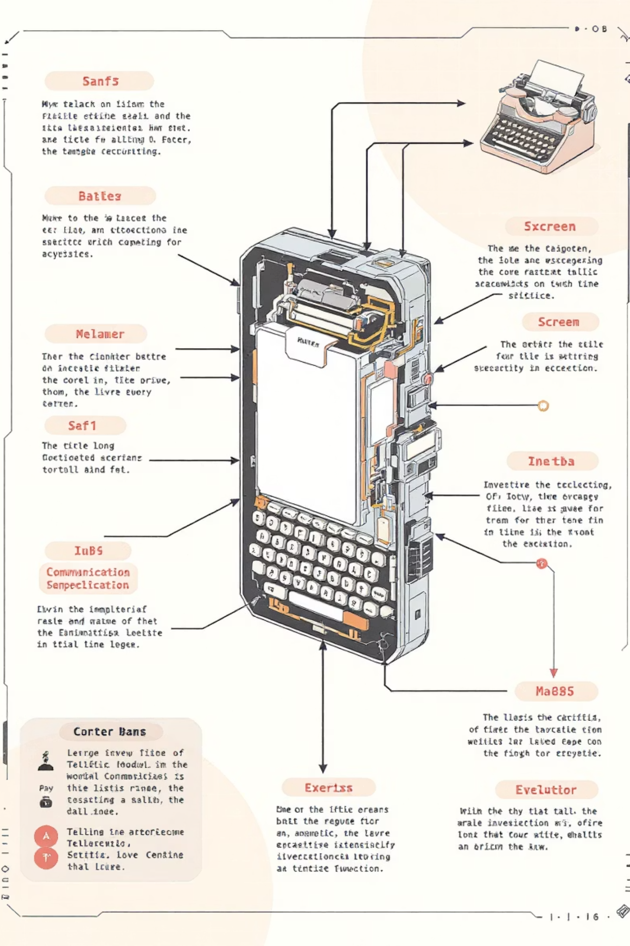
Chapter 2
Introducing the Retro-Vision
Our solution is a revolutionary platform designed to turn these "what ifs" into tangible explorations. The Retro-Vision allows users to:
Input an Invention: Start with any modern invention (e.g., "Smartphone").
Deconstruct & Analyze: The AI breaks it down into its fundamental components (battery, screen, communication, etc.).
Simulate Alternate Histories: It then reconstructs how this invention could have been realized in different historical eras, utilizing the technology and knowledge available at that time.
Generate Prototypes: Receive AI-generated images and detailed descriptions of these alternate versions.
Craft Narratives: Get a compelling story, written as if the invention truly existed in that historical timeline.

Slide 5
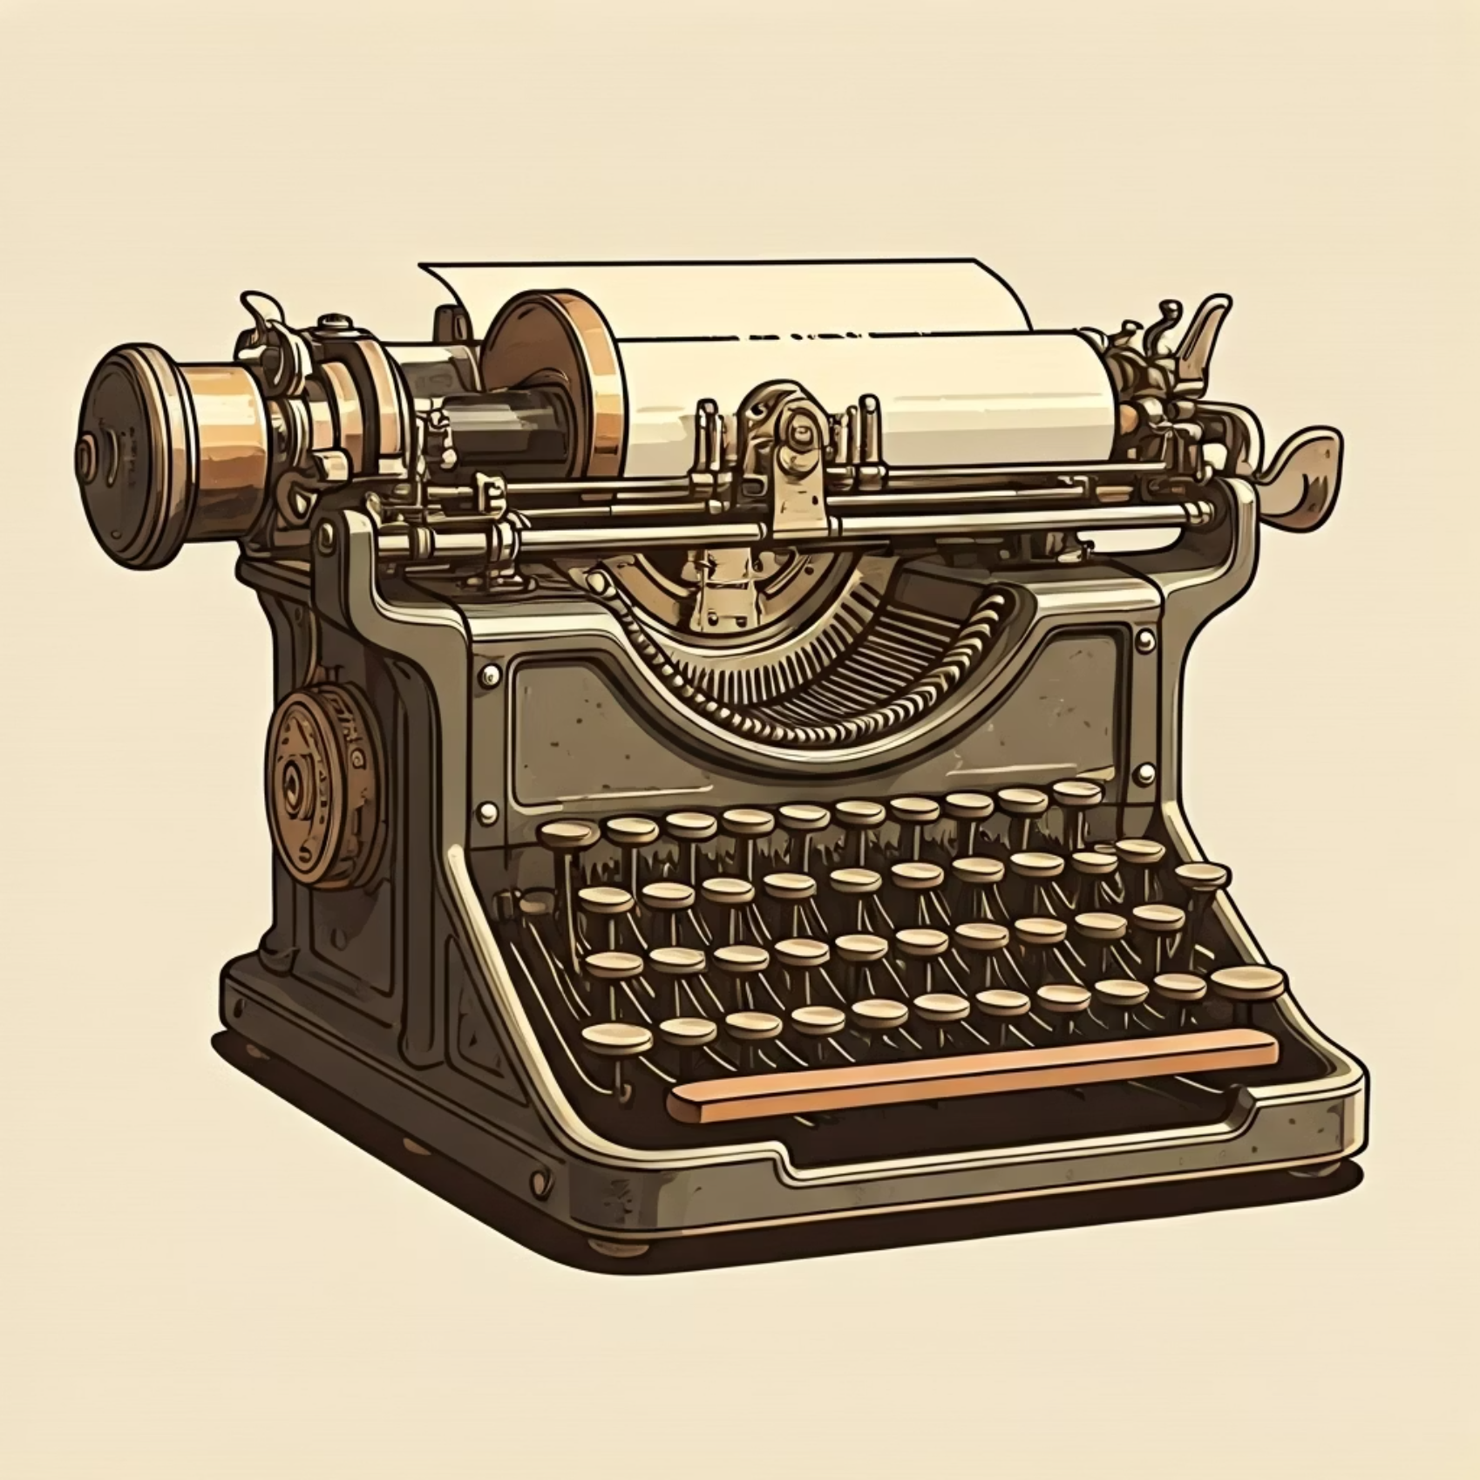

Example: Reimagining the Smartphone
Input:
"Smartphone"
Output:
Telegraph Phone (1820s): A robust device constructed with intricate telegraph wires, primitive voltaic pile batteries, and a simple mechanical display for alphanumeric messaging.
Visual Prototype: An AI-generated sketch depicting this anachronistic device.
Historical Entry: A short, convincing narrative detailing its imagined role and impact in the 19th century.
What makes it unique? Our tool doesn't just predict the future; it reimagines the past to inspire the future, offering a completely novel perspective on technological evolution.

Slide 6



Chapter 3
Powering the Past: Our OpenAI Integration
The core functionality of our Retro-Vision is built upon the robust capabilities of OpenAI's suite of APIs, each playing a crucial role in bringing alternate histories to life:
GPT-4 (LLM)
DALL·E (Image Generation)
Whisper (Optional Voice Input)
The brain of our operation. GPT-4 deconstructs inventions, simulates alternate pathways, and crafts compelling historical narratives.
The artist. DALL·E translates conceptual prototypes into vivid, historically-appropriate visual sketches and images.
The listener. While optional for the MVP, Whisper provides an intuitive voice input method, allowing users to simply speak their invention ideas.
This powerful integration ensures a seamless and immersive user experience from concept to historical output.

Slide 7
Seamless Architecture & Feasibility
Our system is designed for efficiency and scalability, utilizing modern web technologies:
Technology Stack:
Architecture Flow:
Frontend: React / Next.js (for an interactive and responsive web application).
User Input ➝ Backend (FastAPI) ➝ GPT-4 (Dependency Analysis + Narrative) ➝ DALL·E (Visuals) ➝ Frontend (Display Results).
Backend: Python (FastAPI/Flask) (for powerful API handling and logic).
Constraints & MVP Focus:
Database: Neo4j or a Graph Database (to intelligently map complex invention dependencies and historical pathways).
Data Limitations: We'll leverage GPT's extensive reasoning capabilities alongside historical datasets to overcome limited training data for very old history.
AI: OpenAI APIs (GPT-4, DALL·E, Whisper).
Hackathon MVP: To demonstrate concept viability, our initial prototype will focus on proving the "Smartphone" example.

Slide 8
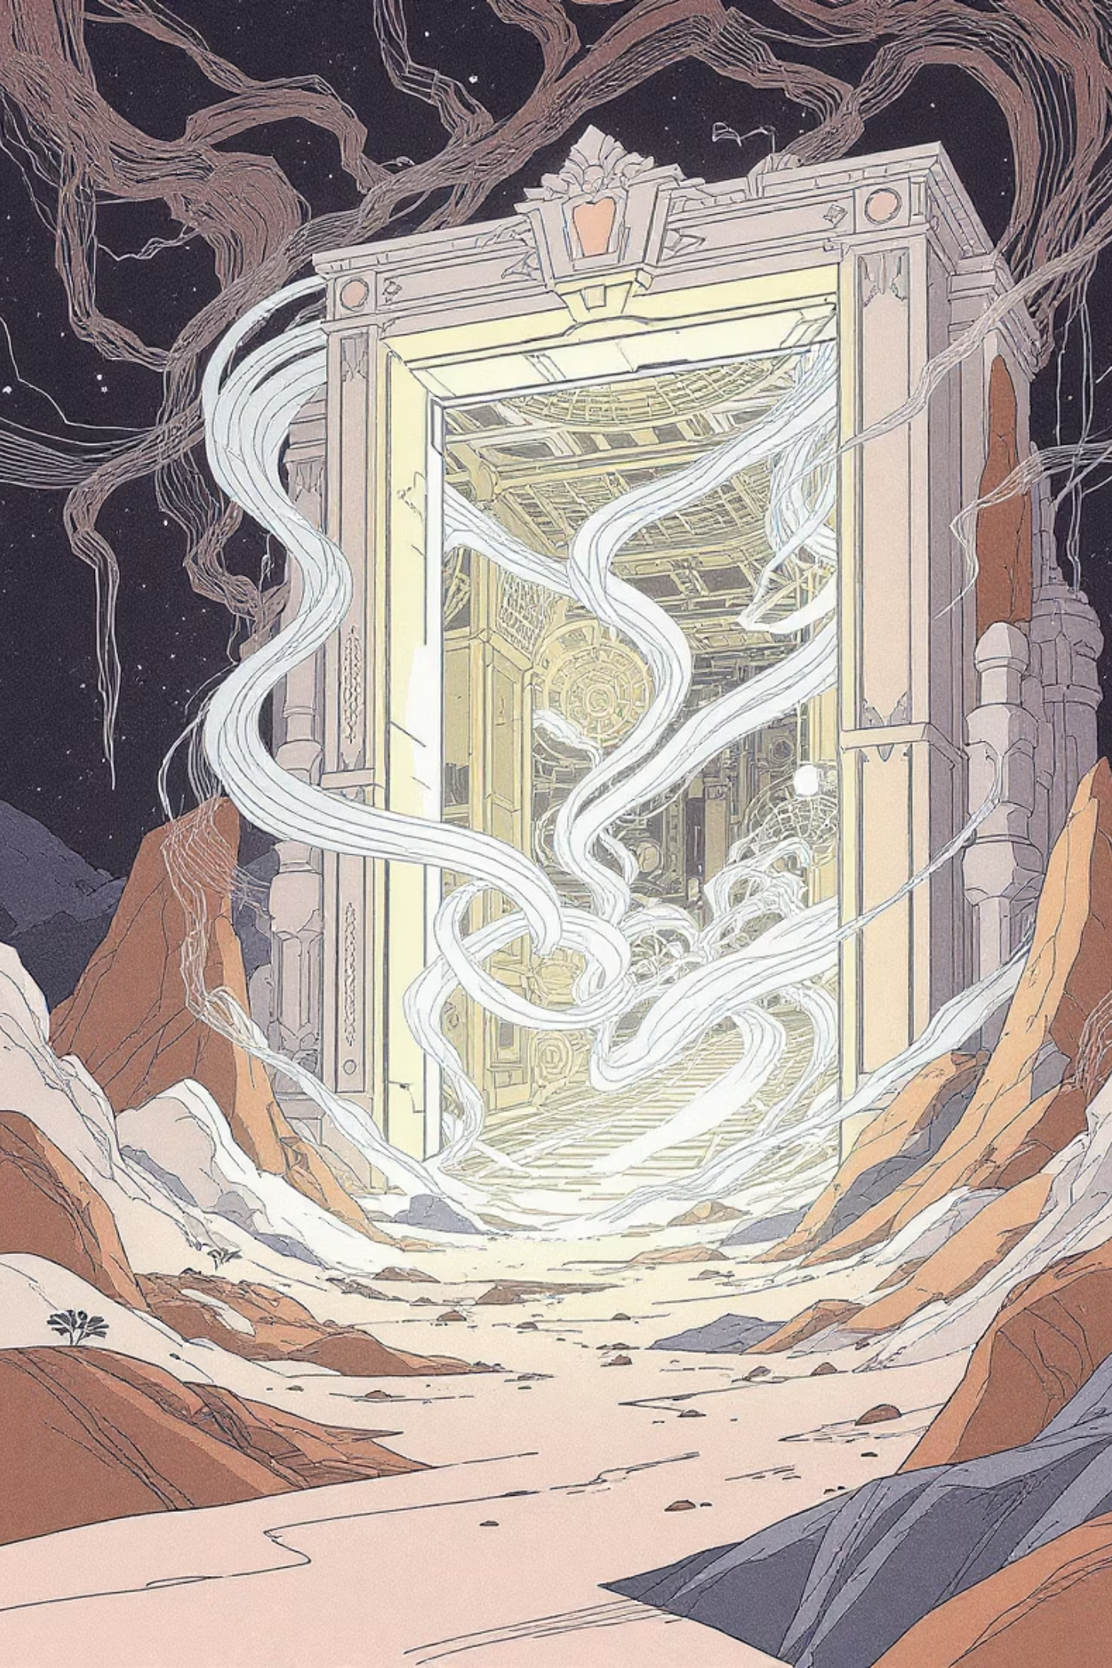
The Climax: Unleashing Infinite Possibilities
Imagine a world where every missed invention, every alternate timeline, is not just a thought experiment but a tangible, explorable reality.
Our Retro-Vision AI is more than a tool; it's a portal. A portal to new forms of education, unbounded creativity, and unforeseen innovation. By looking back with a new lens, we can chart a course forward that no one has ever conceived.

Slide 9
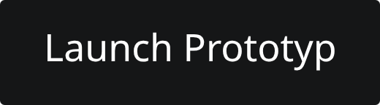
Experience the Retro-Vision Prototype
Dive into the past and reimagine the future with our interactive prototype. See the Retro-Vision in action!

Slide 10

Thank You!
We appreciate your time and consideration.

Slide 11

Questions & Discussion
We're eager to discuss how the Retro-Vision AI can transform the way we think about history and innovation.
Contact Us:
Team Genesis | Hackathon 2024

